Slide 1
TOWN CLERK FY24 vs FY25
FY24 – TWO ELECTIONS
FY25 – THREE ELECTIONS
March 5, 2024 Pres. Primary
May 7, 2024 Town
September 3, 2024 State Primary
November 5, 2024 Presidential
May 6, 2025 Town

Slide 2
T.C. DEPARTMENT UPDATES
Carol Ducrow Retired 1/31/24
GRADE 2 Vacancy
INTERVIEWS
District-Wide Recount; 1ST Essex & Middlesex

Slide 3
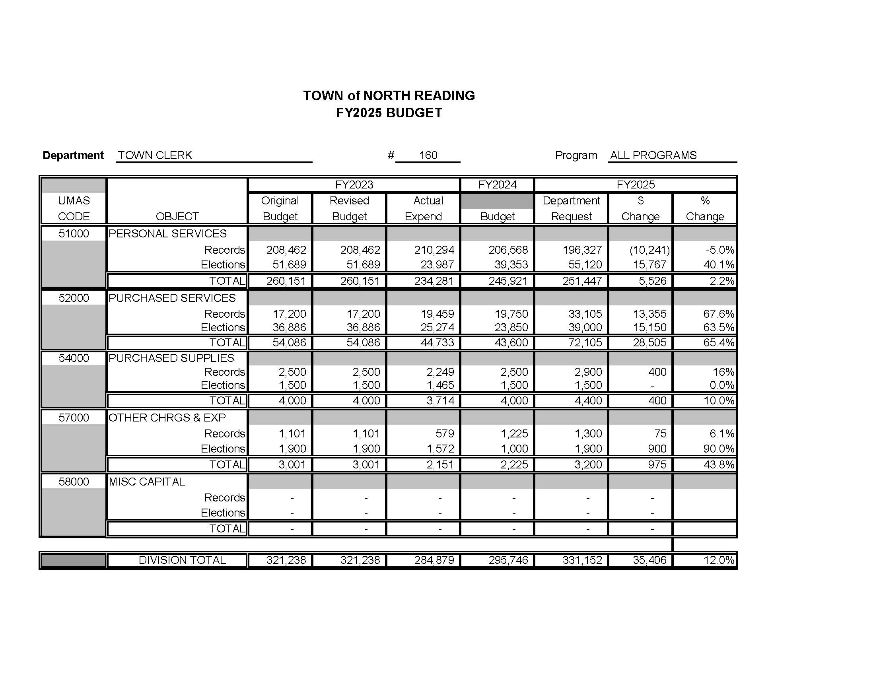
TOWN CLERK FY25 BUDGET

Slide 5
Thank You! Comments, questions or concerns?

