Slide 1
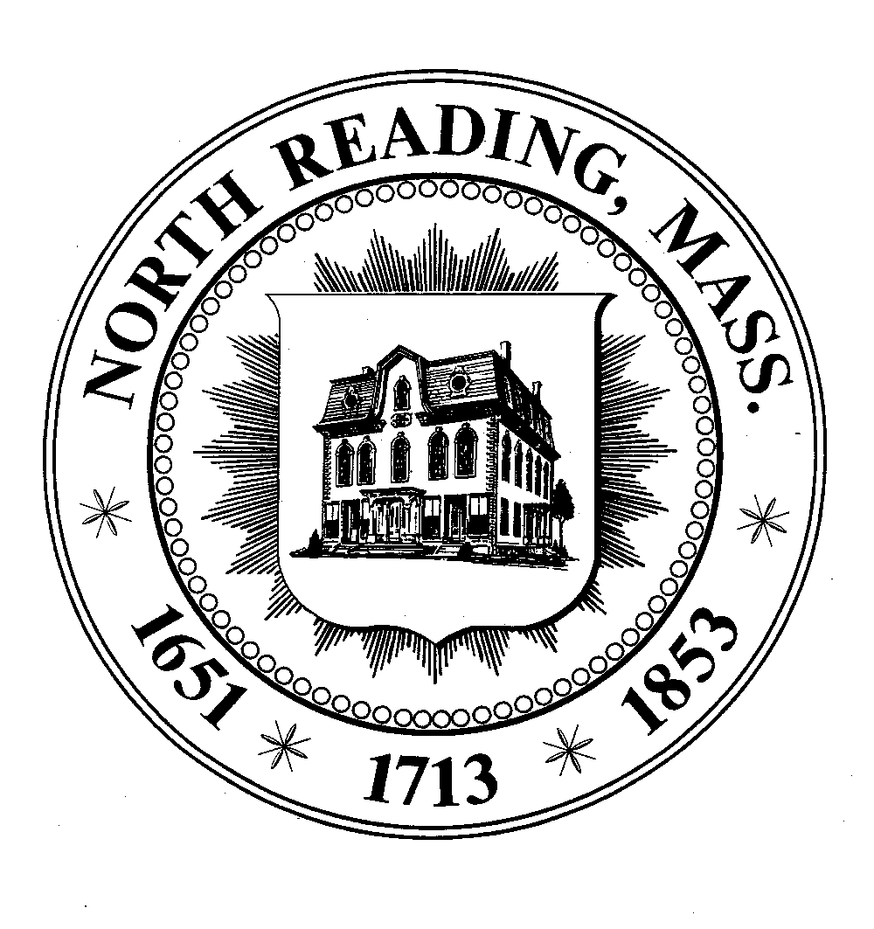
MWRA WATER SOURCE TOWN MEETING OCTOBER 05, 2015
7:30 PM
NR HIGH SCHOOL PERFORMING
ART CENTER

Slide 2
North Reading Water: Background
Average supply, based on 2008-2014 data:
0.5 Million Gallons Per Day (MGD) drawn from Town wells (181 million gallons per year)
0.90 MGD purchased from Andover (330 million gallons per year)
Total North Reading consumption is 511 million gallons per year
Rely on water use restrictions to manage consumption within these limitations
Projected 2033 Demands calls for 584 million gallons
What’s the Impact on Economic Development?
Notes:
MAKE SURE TO THANK THE PUBLIC FOR STICKING TO THE RESTRICTIONS

Slide 3
Long-Term Water Issues/Needs
Town Wells are Projected to Need Significant Capital Investment
Andover has Previously told the Town it Cannot Provide for all of Our Future Water Needs
Even with Wells Operating at Full Capacity, We Will Still be Short of Our Demand and Will Continue to have Significant Stress on the Ipswich River
Pursuit of Current/Additional water from the Ipswich River Water Basin is Anticipated to Face Regulatory Opposition at the State Level
For Long-Term Health, Quality of Life, and Sustainable New Growth, the Town Needs Quality & Reliable Water Resource

Slide 4
Keep Existing Infrastructure and Connections
MWRA Connection
Estimated Costs of $21M in Infrastructure Investments within the Next 3 to 15 years
Major Investments Required for Town Wells/Pumps
Andover Water Rates Projected to have a Major Increase
Gives Town “NO” Increase in Gallons Per Day – Max @ 511 Mil
Cannot Support New Growth
Continued Water Restrictions
Manpower Resources Increase & Lack of Knowledgeable Operators
Major Risk with Regulatory Restrictions
Estimated Costs of $17.13M + in Infrastructure Investments and Connection Costs Over Next 3 yrs
Reliable Water Source
Improved Water Quality
Can Meet 584 Mil Gal. Future Demand
Supports New Growth and Increases in Economic Development
Reduces Labor Costs and Need for Subject Matter Experts (SME)
No Risk of Regulatory Restrictions
Greatly Reduces Risk of having Water Restrictions – Improved Quality of Life Factor

Slide 5
Long-Term Budget Projection
FY 2016- 2025 Water Enterprise projected budget increases
FY % Increase
2016 7.7%
2017 8.8%
2018 6.9%
2019 8.5%
2020 11.1%
2021 3.2%
2022 6.4%
2023 9.2%
2024 4.8%
2025 2.8%
Average over 10 years is 6.9%

Slide 6
Aid and Assistance
State Aid
Community Compact Cabinet– Governors Partnership with Cities and Towns to Help Achieve New Opportunities and Growth.
Committed $25K to Fund Water Infrastructure Research the HELPS Economic Development
MassWorks Infrastructure Program – Provides Public Infrastructure Funding to Support Economic Development
Clean Water State Revolving Fund– Offers Zero Percent Interest Rates
State Legislators & Grants– State Representative Jones and Senator Tarr are Committed to Find Additional Sources of Financial Assistance
MWRA and Town of “Reading” are Making a Major Commitment and Investment
Notes:
MassWorks is administered by Exec Office of Housing and ED – Sec Jay Ash Visiting NR on Oct 16th

Slide 7
Economic Development Impacts
Having Well-Maintained Water Infrastructure System is VITAL to our Community Long-Term Health, Environment and ECONOMIC DEVELOPMENT (ED)
ED is Key to Funding Long-Term Debt and Future Expenses rather than solely on the back of Rate Payers/Taxpayers
Need Additional Water Resources to Capture New Growth
Economic Development Committee (EDC) Charge
Develop a Plan for the Reuse of the Old JT Berry Property
Future Commercial Growth on Concord Street and Route 28
Notes:
MassWorks is administered by Exec Office of Housing and ED – Sec Jay Ash Visiting NR on Oct 16th

Slide 8
Massachusetts Water Resource Authority (MWRA)
MWRA has Ongoing Capital Work to Provide Additional Capacity and Reliability North of Boston
High Fells Reservoir in Stoneham
Redundant Loop
MWRA has the Capacity to Serve North Reading’s Future Needs and Help Achieve Economic Development.
State Regulators are Aware and Actively Working to Make MWRA a Viable Option
MWRA will Help Reduce the Stress on the Ipswich River
Significant Improvements in Water Quality
With On Going Changes in Regulatory Rules, MWRA Connections Reduces risk to North Reading

Slide 9
MWRA Connection Through Reading
Two communities have been collaborating since 2014.
Projected $9.45 million in permitting, design, and construction in Reading and North Reading (construction bonded over 20 years, may be zero percent interest loan eligible)
$7.68 million to “buy-in” to the MWRA (financed by the MWRA but re-paid by the Town; may be grant eligible)
These Costs are Spread over 25 Years at Zero Percent Interest
Equates to $307,200 Annually
Annual debt service (Construction Costs) for MWRA connection ranges from:
Low of $310,825 in FY 17
High of $835,775 in FY 19
Note that the debt service and buy-in fee go away after 20 and 25 years, respectively

Slide 10
Permits and Approvals
Inter-Municipal Agreement with Reading – Spring 2016
TOWN MEETING Approval – June 2016
Massachusetts Environmental Policy Act (MEPA)
Draft Report Submitted for Public Comment end of 2015
Final Report Submitted Spring 2016
Water Resource Commission (WRC)
MWRA:
Advisory Board
Board of Directors
State Legislature
Governor

Slide 11
When Will this Happen?
Engineering, Financial Analysis, and Project Planning Currently Underway
Target Date for MWRA Connection Activation - July 2019
Preliminary Design Funding Appropriated Oct. 2015
Design – Estimated June 2016 to June 2017
Construction – Estimated June 2017 to June 2018
Public Workshops held throughout Process
Check for Updates on Link on Town Website
http://www.northreadingma.gov/water-division/pages/waterwastewater-deir

Slide 12
Questions and Answers
Thank you for your continued support and cooperation as we navigate through this challenging transition.

