Slide 1
Social Media and Digital Boundaries
Amy Luckiewicz, DFC Project Director Det. Paul Lucci, North Reading Police

Slide 2
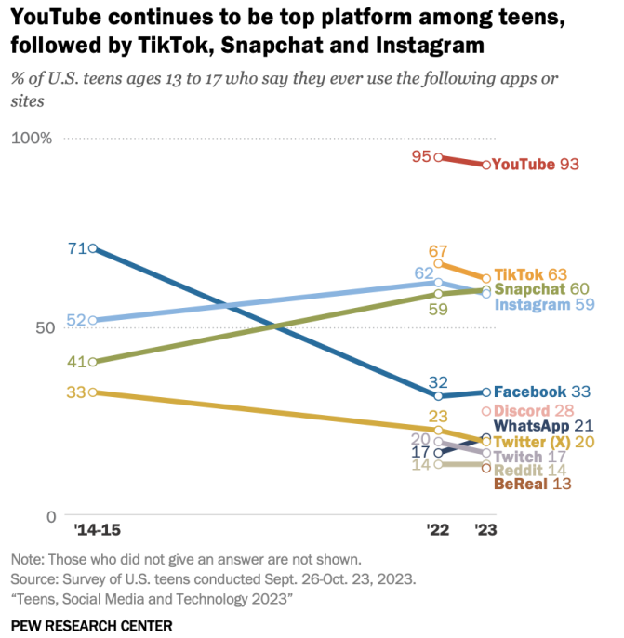
Social Media Popularity

Slide 3
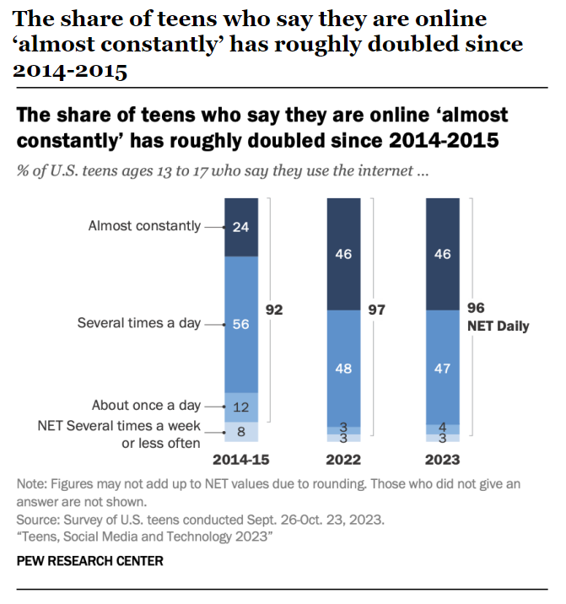
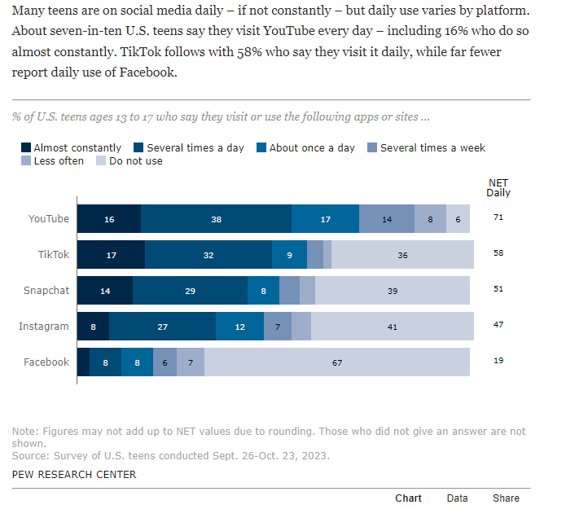
Social Media Popularity

Slide 4
Influencers
Parents need to know that when children go online, they are entering a world of influencers, many of whom are hoping to make money by pushing dangerous products. It’s a world that’s invisible to us, because when we log on to our social media, we don’t see what they see. Thanks to algorithms and ad targeting, I see videos about the best lawn fertilizer and wrinkle laser masks, while Ian is being fed reviews of flavored vape pens and beautiful women livestreaming themselves gambling crypto and urging him to gamble, too. -Emily Dryfuss
Citation: Our Kids are Living in a Different World (New York Times) Jan 12, 2024
Dreyfuss is a co-author of the book “Meme Wars: The Untold Story of the Online Battles Reshaping Democracy in America.”

Slide 5
Influencers: Kids Online Safety Act
Bipartisan act, awaiting a Senate vote (as of 3/27/24)
The bill has decent prospects of passage, but it doesn’t directly address the issue of unpaid influencers.
As the bill now stands, state attorneys general could take the social-media platforms to court for amplifying specific kinds of harmful content to those 16 and under, including the promotion of tobacco, gambling and alcohol.

Slide 6
Risks of Social Media Use
Cyberbullying criminal harassment, hate crimes, violence
Exposure to inappropriate content pornography, drugs, alcohol abuse, violence
Privacy concerns oversharing, location sharing, allowing people you do not know to be friends
Predators pedophiles, scammers, pimps
Child Pornography sexting, predators, websites, embarrassment
Sextortion scammers, pedophiles, other students
Human Trafficking grooming, addiction, drugs, sex slavery, violence
Addiction drugs, alcohol, pornography

Slide 8
Snapchat: What it looks like when you open Snapchat
To access profile
and settings
Add Friends/Quick Add
What your phone camera sees
Snaps/Chats
Snap Map
Stories
Access Photos
Saved Snaps
My Eyes Only
Spotlight

Slide 9
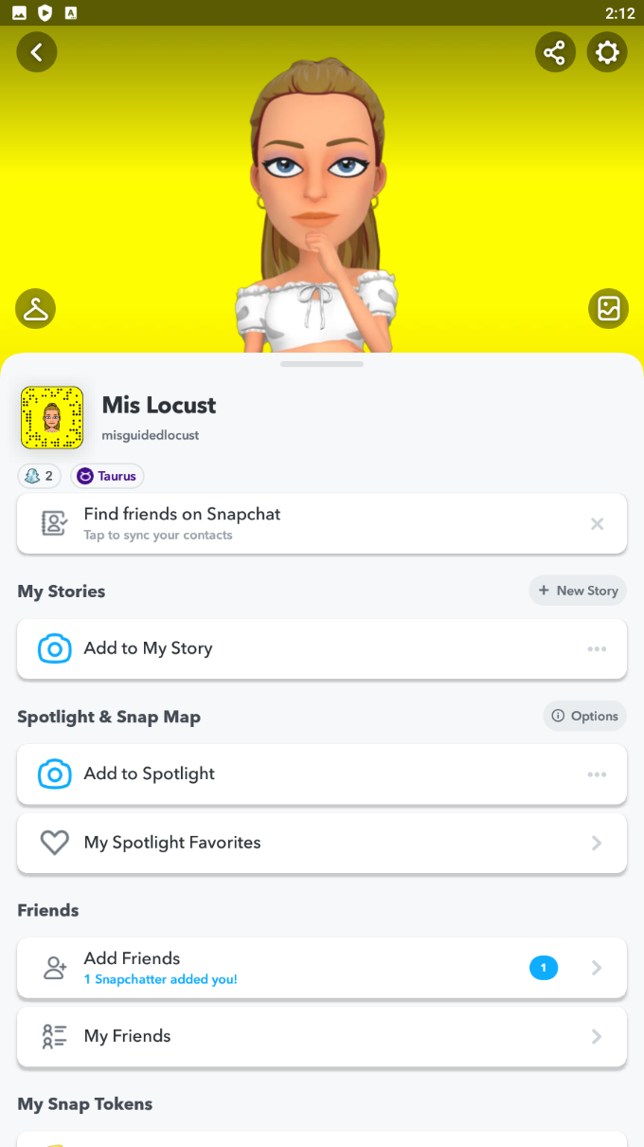
Snapchat: Settings
Settings

Slide 10
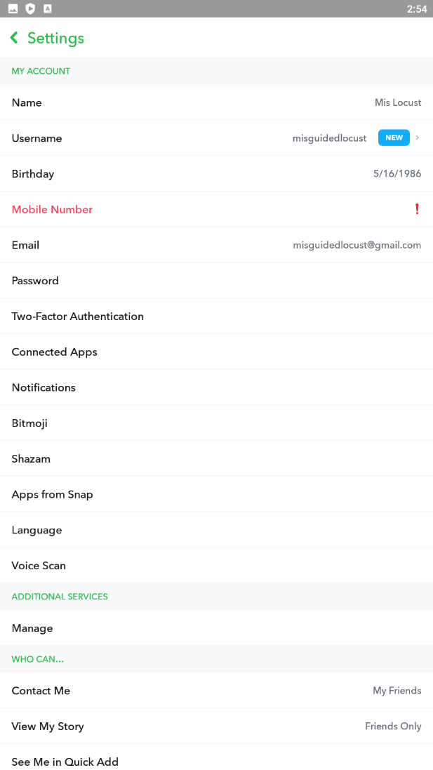
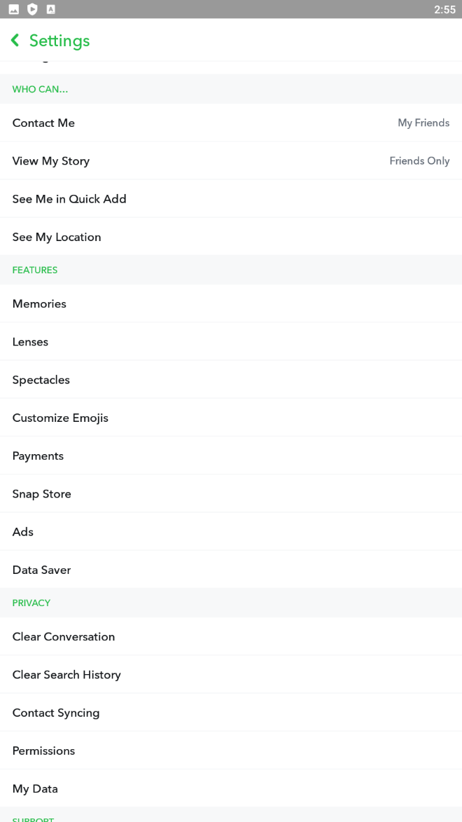
Snapchat: Suggested Settings
view friends
set to friends only
Click and select show me in quick add toggle OFF
Click to view Snap Map settings
top of settings
(scroll down)
midway settings (scroll down)

Slide 11
Snapchat: Suggested Location Settings
Click to view Snap Map settings
This opens another box
midway settings (scroll down)
Turn ON Ghost Mode

Slide 12
Snapchat: How to view Snap Map
There are 2 ways to get to Snap Map:
1. By the bottom of the profile page
(Scroll down)
Snap Map: Not Sharing Location (Ghost Mode) *CLICK*
Notes:
Talk about profile and the features it has.
Next go to Snapmap and explain

Slide 13
Snapchat: How to view Snap Map
2. From the Home Screen
(Home Screen)
To Snap Map

Slide 14
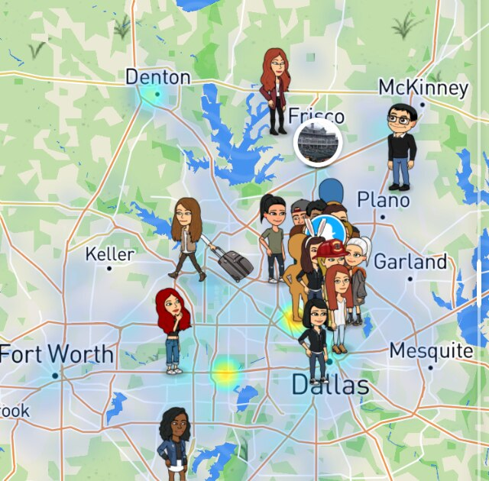
Snapchat
What most kids’ Snap Maps look like

Slide 15
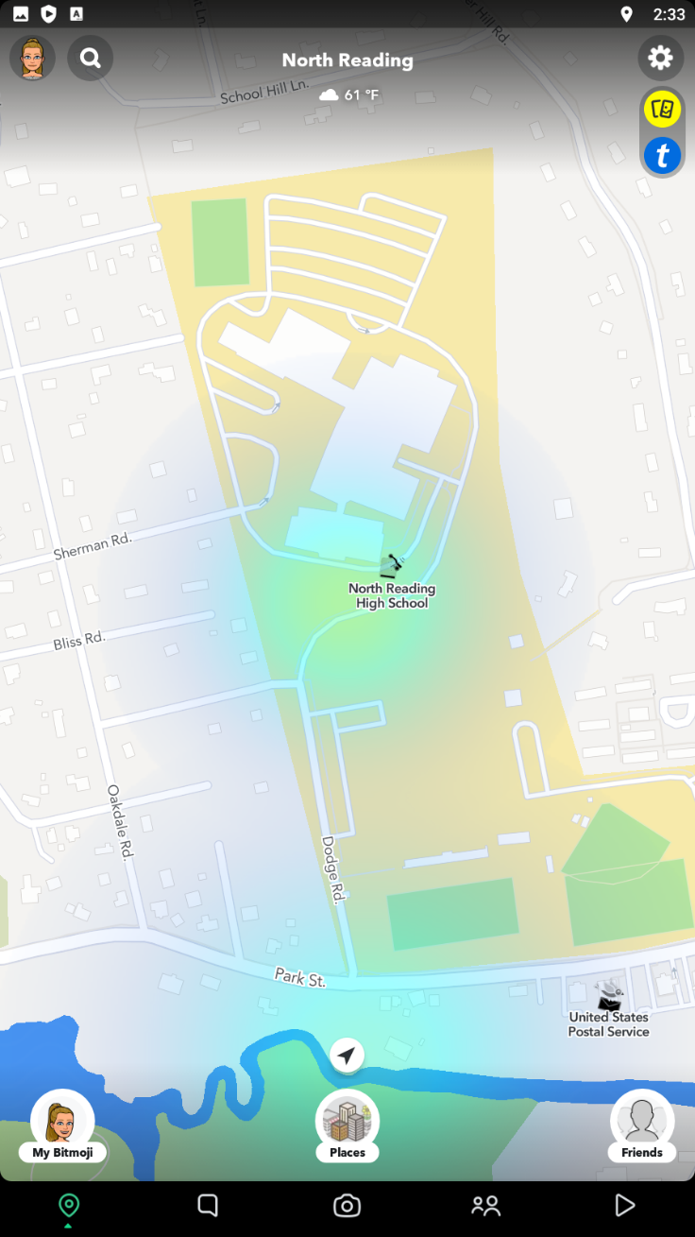
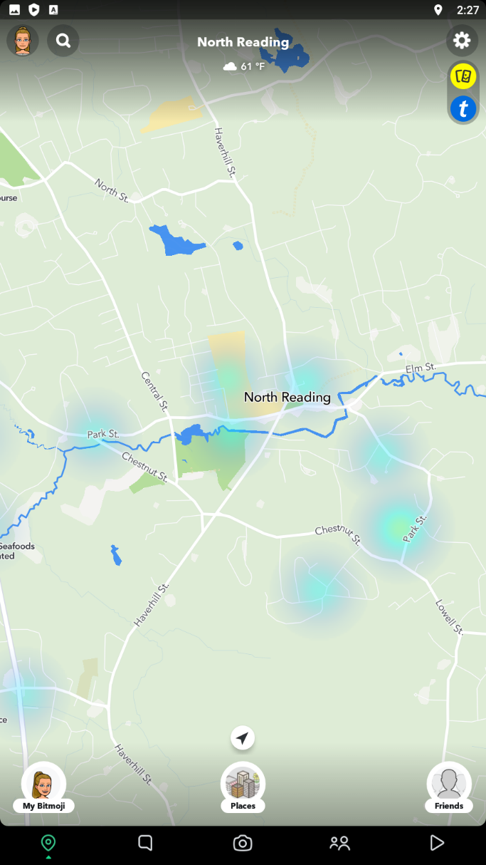
Snapchat
The “heat” of a Snap Map shows the location (in color code) of public posts by quantity.
The redder the area, the more posts originate from that location.
NRHS/NRMS
Notes:
I searched NR and explain what the heat map shows and what it does.
Let's zoom in and see a very detailed overview layout of the High School.
Click the heat map

Slide 16
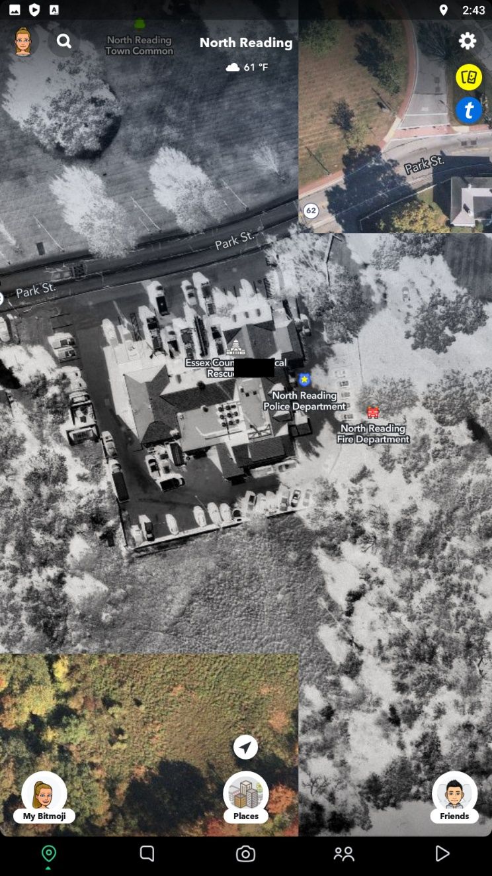
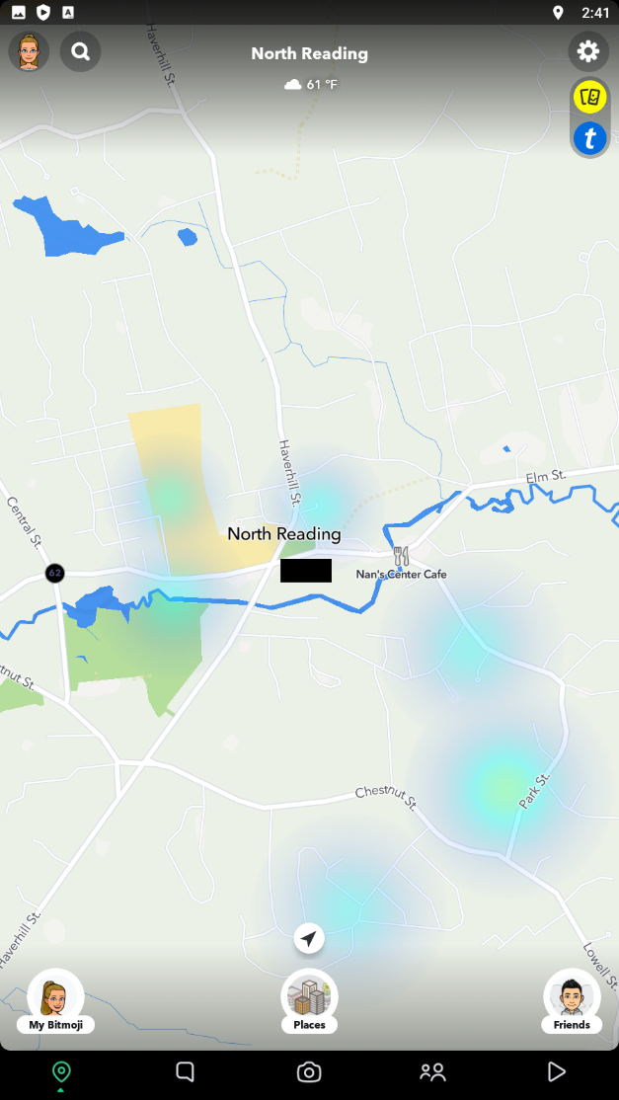
Snapchat
Find My Location (from the Snap Map)
Location is very precise to what side of the building I am located.
My Bitmoji
(An example of a Bitmoji on the map)

Slide 17
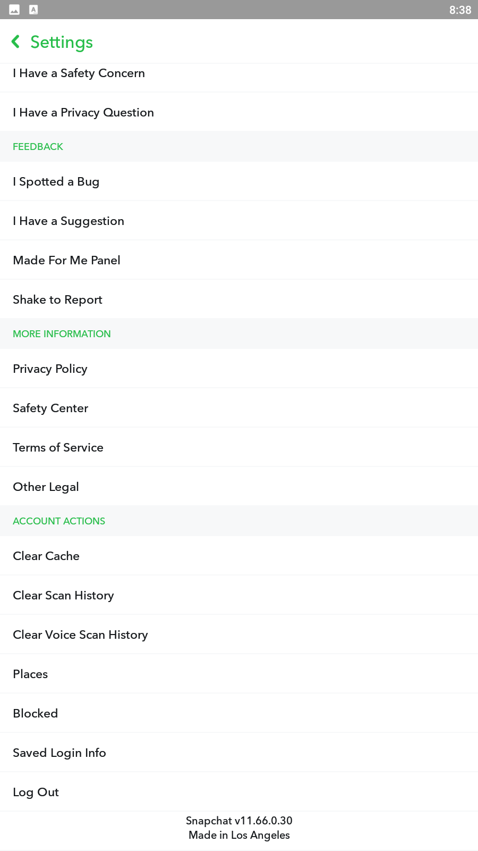
Snapchat
Locations the user has been tagged, tagged themselves, or has favorited. Look to see where they have made locations tags.
Check and see who your student has blocked and then ask them why. They may have their privacy settings set to allow anyone to contact them.
If this is the case change the setting back to only friends can contact them. Also make sure they only friend people they know IRL!

Slide 18
Snapchat: Family Center
How to Navigate to Family Center
Settings, scroll to the Privacy Controls Section, Tap Family Center
Go through setup
Friend your student’s Snapchat account
Go to the invitation screen and select your students Snapchat name.
Invitation will be sent, make sure they accept.
Parental Controls: Family Center
Parents must be registered with DOB over 25.
Lets you see which Snapchat friends your student have sent messages, photographs, videos in the last 7 days. Note: You can not see their content.
See complete list of their teens existing friends and easily view new friends.
Limit their teen's ability to view certain content like stories and spotlights
Report accounts.
What is family center: https://help.snapchat.com/hc/en-us/articles/7121384944788-What-is-Family-Center-
How to find Family Center: https://help.snapchat.com/hc/en-us/articles/8117064956948
Parent Guide: https://help.snapchat.com/hc/en-us/articles/7047492972564-Download-A-Parent-s-Guide-to-Snapchat-

Slide 19
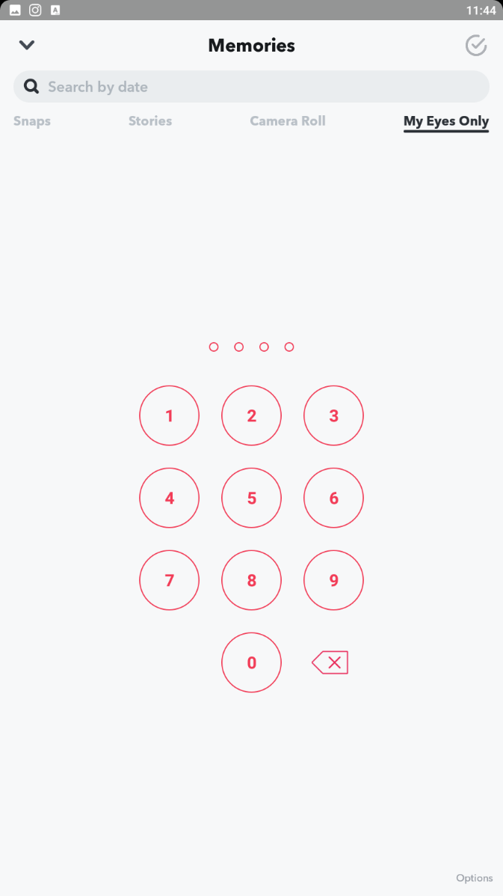
Bonus! Snapchat’s My Eyes Only
What is it?
Fully encrypted picture locker
Snapchat does not even know what's inside
Forensic imaging doesn’t know what is inside
Lose the password, you lose access
Does your student know the PASSWORD?
Movie: Seven

Slide 20
Bonus! Snapchat’s My Eyes Only
How to access My Eyes Only
(Home Screen)
Access Photos
Saved Snaps
My Eyes Only

Slide 21
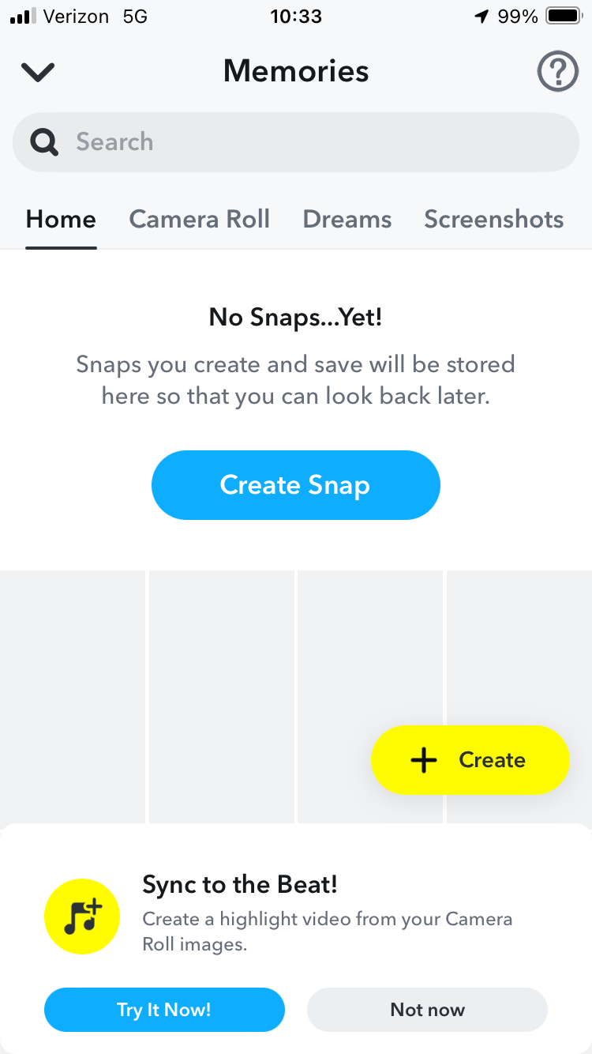
Bonus! Snapchat’s My Eyes Only
Swipe top row to the left

Slide 22
Bonus! Snapchat’s My Eyes Only
Click My Eyes Only

Slide 23
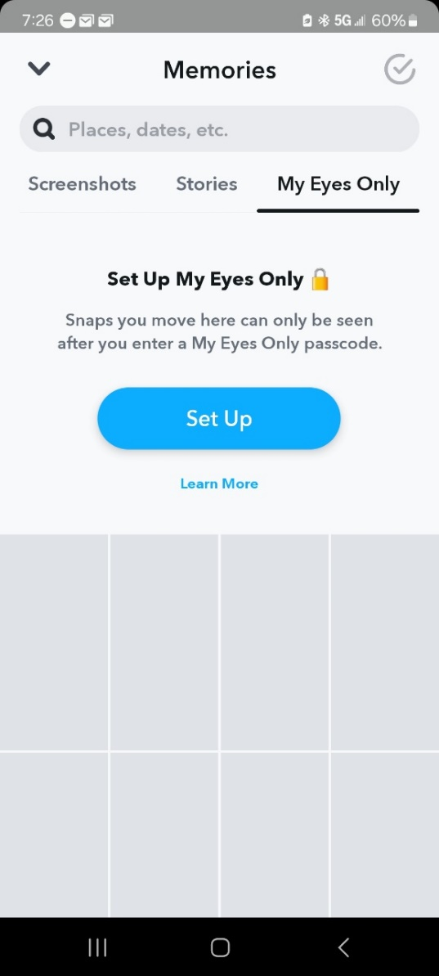
Bonus! Snapchat’s My Eyes Only
If you see this screen, your student has NOT set up a My Eyes Only

Slide 24
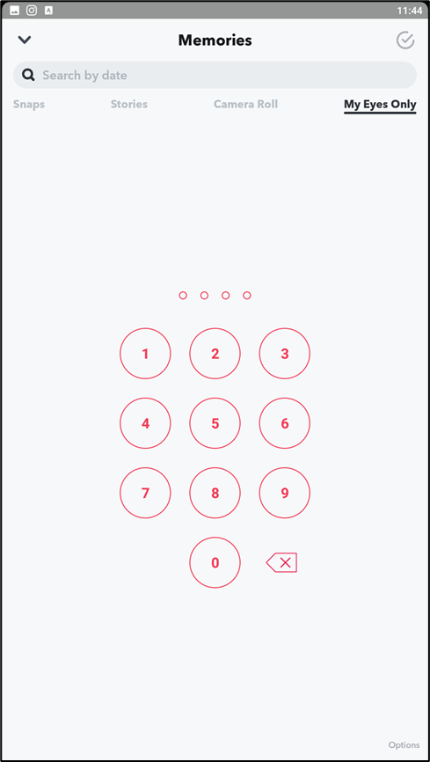
Bonus! Snapchat’s My Eyes Only
If you see this screen, your student HAS set up a My Eyes Only

Slide 26
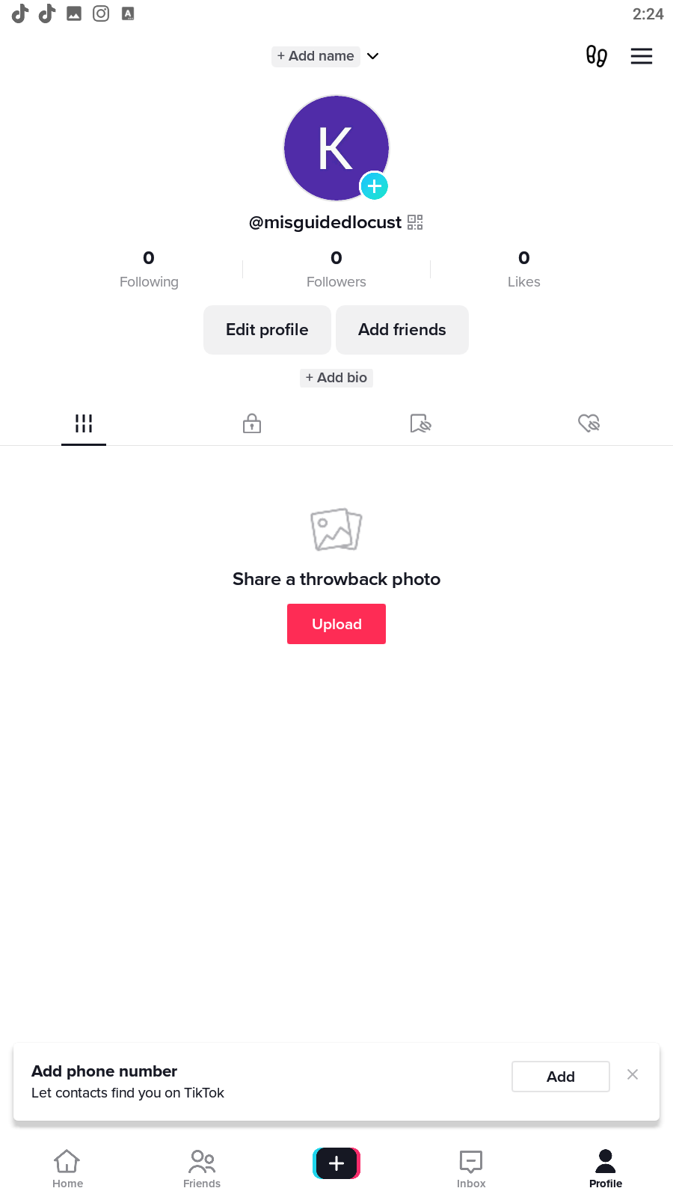
TikTok
Go to settings
Profile Screen

Slide 27
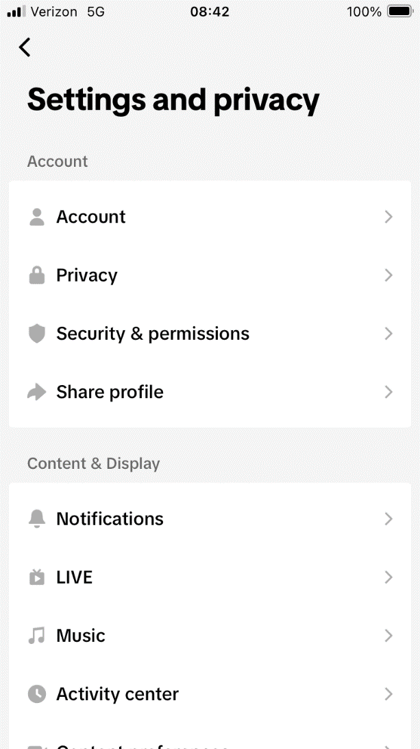
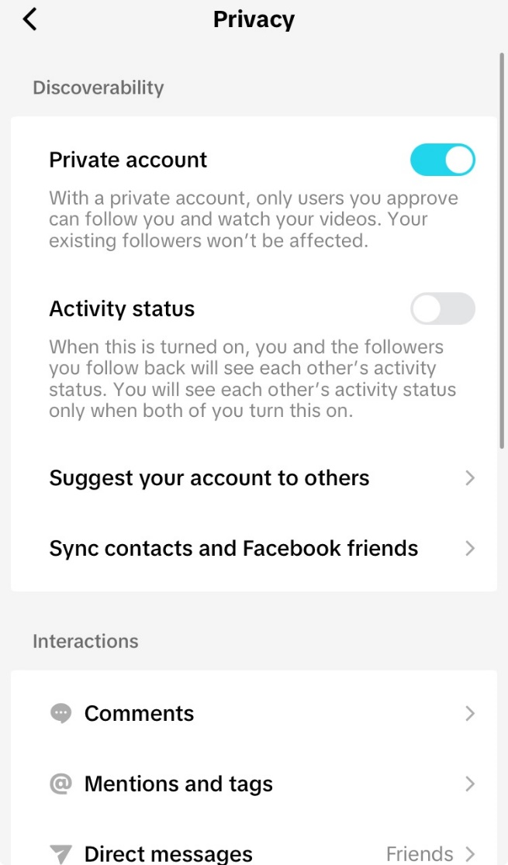
TikTok: Setting Overview
Set this to Private
Privacy
Activity Status Off

Slide 28
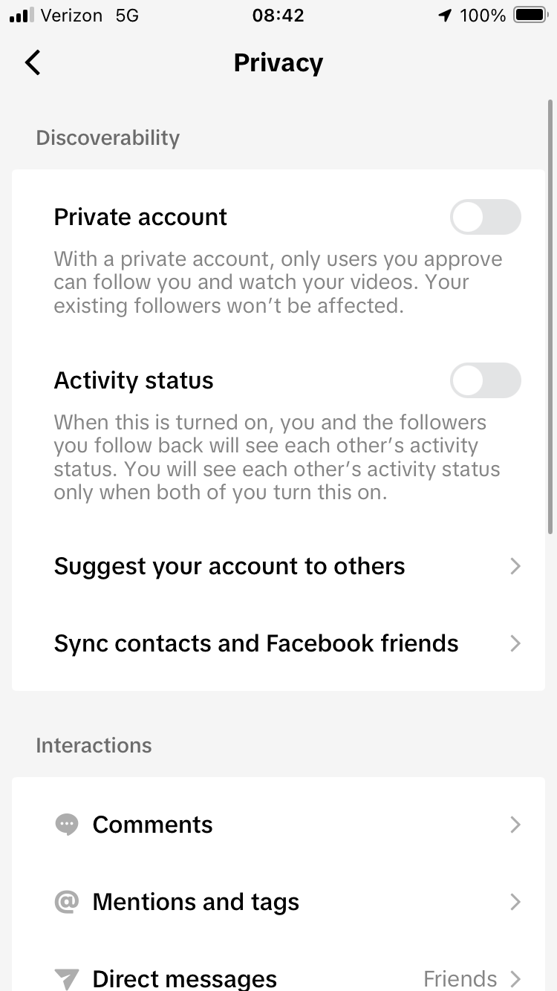
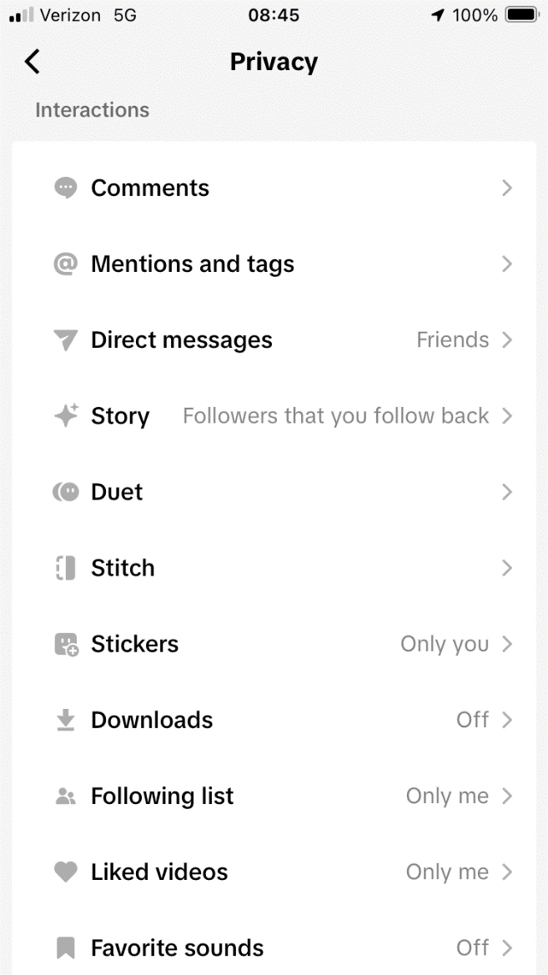
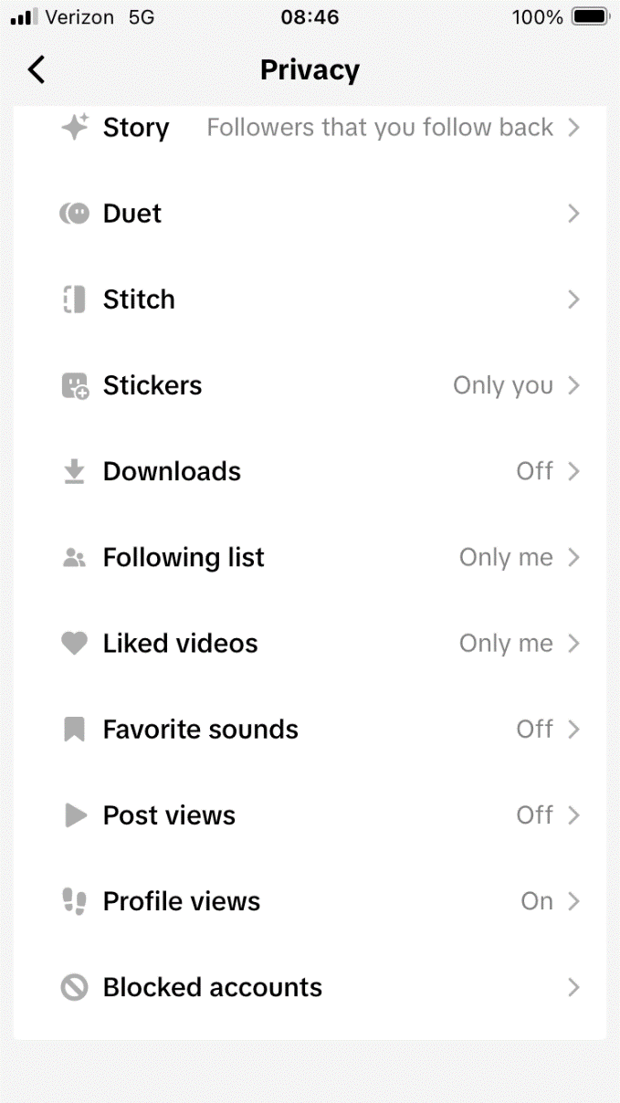
TikTok: Setting Overview
Followers that you follow back
Followers that you follow back
Scroll Up
Only You
Only You

Slide 29
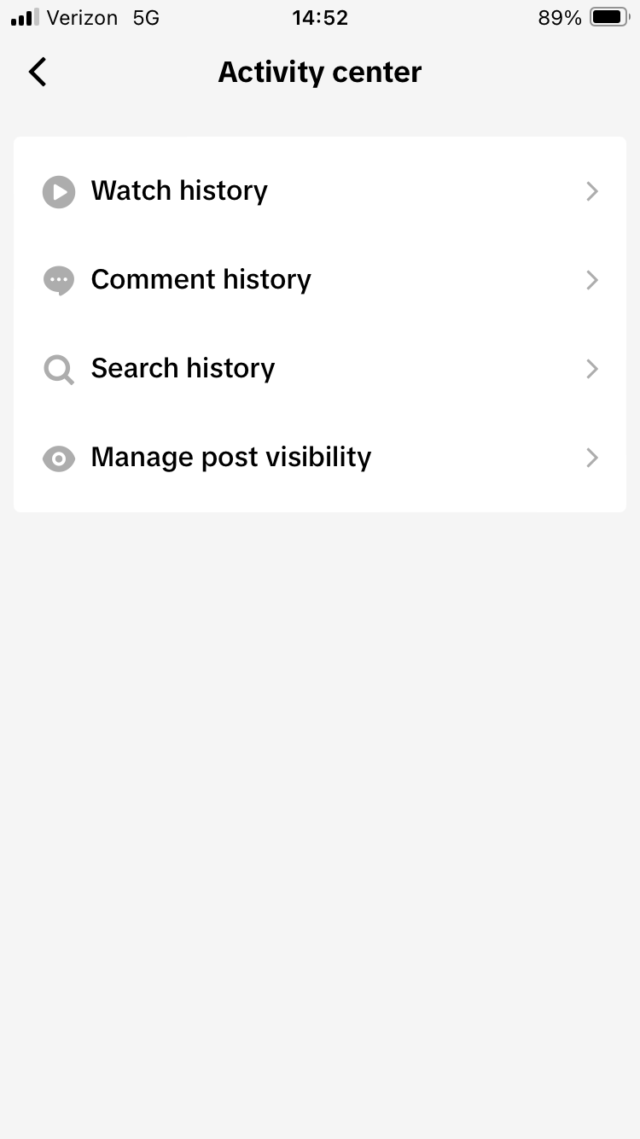
TikTok: From Setting and Privacy Menu
See all videos your student has watched
Read all comments they leave on other videos
Select Activity Center
See all Search History

Slide 30
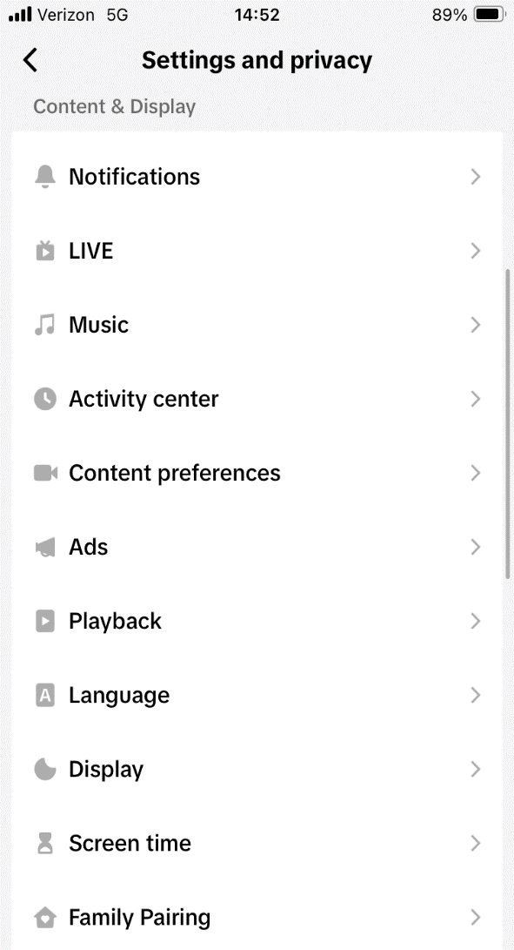
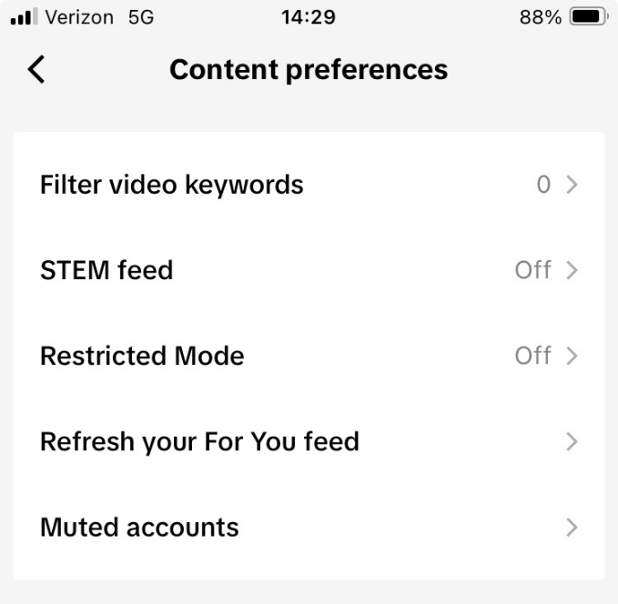
TikTok: From Setting and Privacy Menu
Select Content Preferences
Scroll Up
TURN ON Restricted Mode: Allows users to limit videos that may be inappropriate.

Slide 31
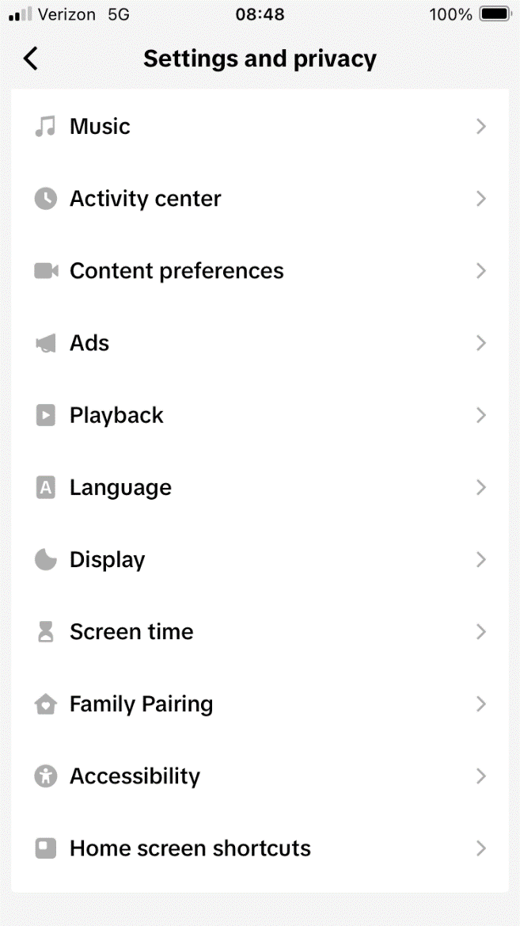
TikTok: From Setting and Privacy Menu
Screen time:
Let’s you set daily screen time limits.
Set screen time break reminders
Gives summary of screen time metrics
Family Pairing:
This is where you set up family pairing
Scroll Up MORE

Slide 32
TikTok: Family Pairing
Family Pairing on TikTok allows parents and teens to customize their safety settings based on individual needs. A parent can link their TikTok account to their teen's and set parental controls including:
Limit screen time and review on a dashboard
Manage push notifications
Filter video key words
Pairing

Slide 33
TikTok: Family Pairing
Family Pairing on TikTok allows parents and teens to customize their safety settings based on individual needs. A parent can link their TikTok account to their teen's and set parental controls including: Daily screen time • Decide how long your teen can spend on TikTok each day. For teens between the ages 13 to 17, this setting is turned on by default to 1 hour. • Set your teen's screen time limit directly from your own account. • Set one screen time limit to apply to all your teen's devices. • Set a passcode that you can choose to enter after your teen reaches their time to allow them to return to TikTok. Screen time dashboard • Get a summary of your teen's time spent on TikTok including: ༚ The cumulative time spent each day for the last 4 weeks ༚ The number of times your teen opened the app each day for the last 4 weeks Learn more about screen time on TikTok.

Slide 34
TikTok: Family Pairing
Mute push notifications • Decide when to mute your teen's push notifications. This setting is turned on by default: ༚ For teens between the ages of 13 to 15 years, the scheduled time is set to 9:00 PM to 8:00 AM by default ༚ For teens between the ages of 16 to 17 years, the scheduled time is set to 10:00 PM to 8:00 AM by default • Schedule additional time directly from your own account. Keep in mind, the default scheduled time overrides any custom time that falls within the default time. Learn more about how to mute push notifications on TikTok. Filter video keywords • Select keywords or hashtags to exclude from your teen's For You and Following feeds, as well as manage the visibility of your keywords list. STEM feed • Decide whether your teen can view the STEM feed.
Note: This is only available to users 13 years and older in the U.S.

Slide 35
TikTok: Family Pairing
Restricted Mode • Restrict your teen's exposure to content that may not be appropriate or suitable for them. Linked account activity • Get notifications about your teen's activity, such as if your accounts get unlinked, by turning on Customized updates and more push notifications. Search • Decide whether your teen can search for videos, hashtags, or LIVE videos on TikTok. Discoverability • Decide whether your teen's account is private or public. With a private account, your teen can approve who can follow them and view their content. Suggest account to others • Decide whether your teen's account can be recommended to others. Learn more about suggested accounts on TikTok.

Slide 36
TikTok: Family Pairing
Direct Messages • Restrict who can send messages to your teen, or turn off direct messaging completely. Keep in mind: • Direct messaging on TikTok is available only to registered account holders aged 16 and older. • Direct messaging is automatically turned off for registered accounts between the ages of 13 and 15. Learn more about direct messages on TikTok. Liked videos • Decide who can view your teen's liked videos. Comments • Decide who can comment on your teen's videos.
Note: TikTok's Family Pairing parental controls are available only on the TikTok mobile app and not on mobile and desktop browsers. If your teen accesses TikTok from a browser as well as the mobile app, you may want to use the parental controls available on the mobile and desktop browser, in addition to TikTok's mobile app parental controls. To set up screen time limits and restrict your teen's TikTok usage on browsers, visit: • Google's family center for Android and Chrome. • Apple's parental controls for iPhones, iPads, Macs, and Safari.
https://support.tiktok.com/en/safety-hc/account-and-user-safety/user-safety

Slide 37
TikTok: Family Pairing
How to set up Family Pairing
To link parent and teen accounts: 1. In the TikTok app, tap Profile at the bottom. 2. Tap the Menu button at the top. 3. Tap Settings and privacy, then tap Family Pairing. 4. Tap Parent or Teen. 5. Follow the steps in the app to link accounts.
How to manage Family Pairing controls
To manage or view Family Pairing controls: 1. In the TikTok app, tap Profile at the bottom. 2. Tap the Menu button at the top. 3. Tap Settings and privacy, then tap Family Pairing. 4. Select the account you want to manage. 5. Update the controls, as needed.

Slide 38
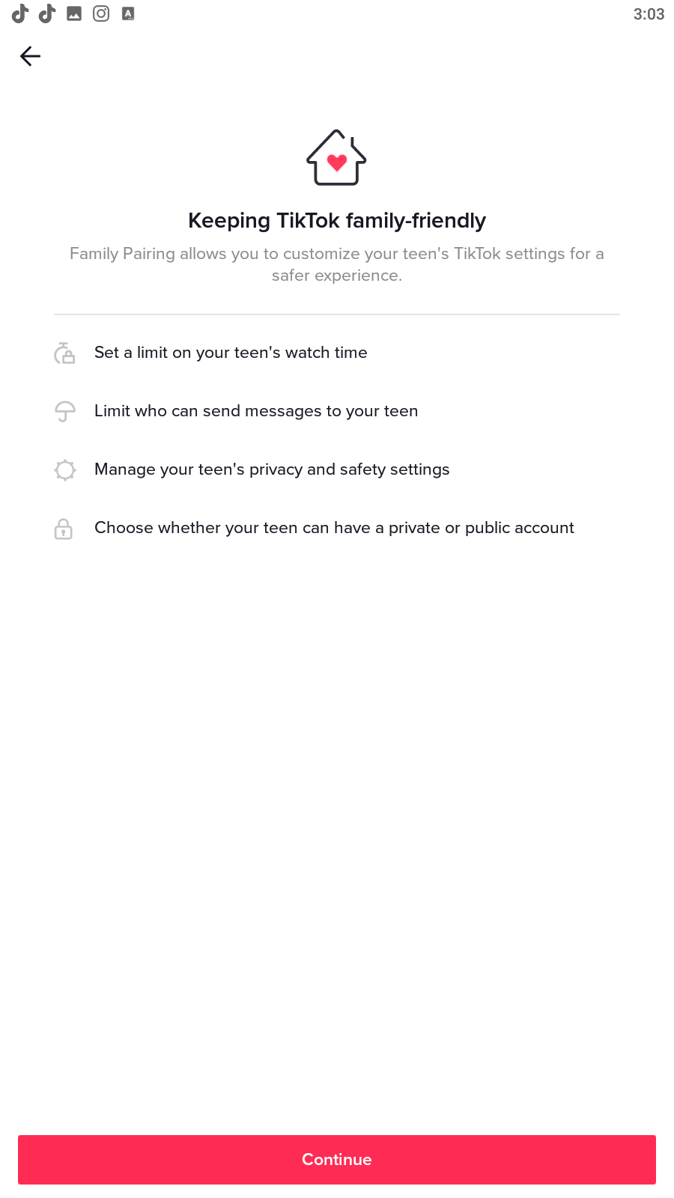
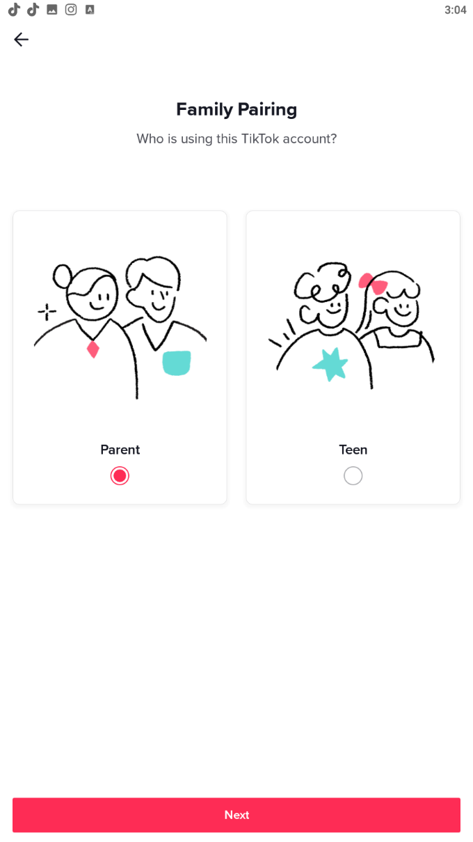
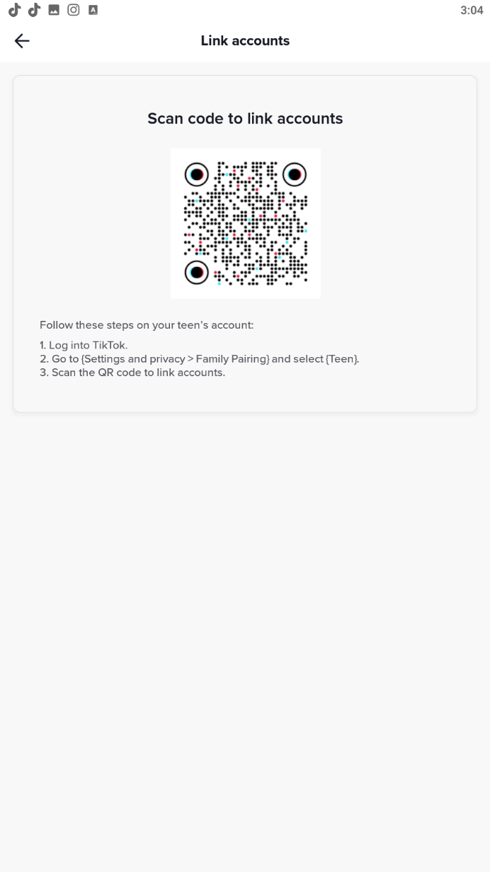
TikTok: Family Pairing

Slide 39
Instagram:

Slide 40
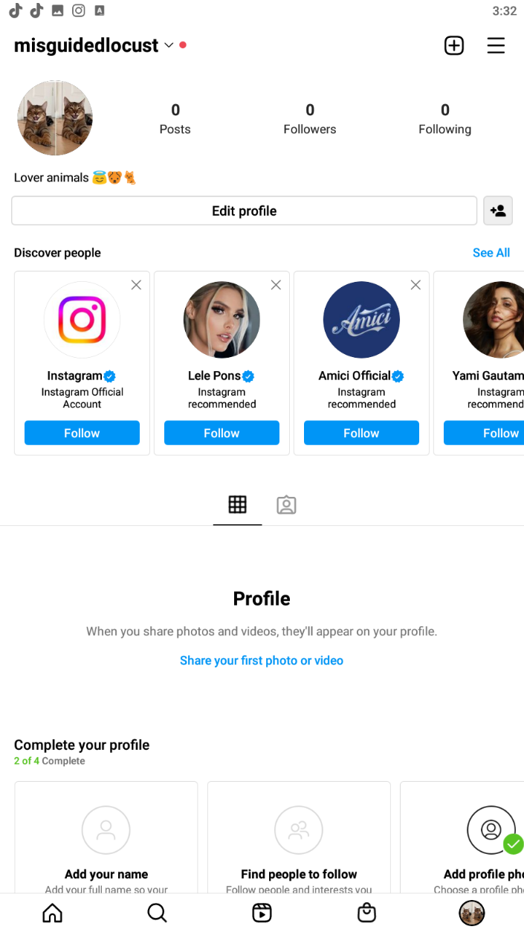
Instagram
Click to go to settings
Profile Screen
View tagged post from other users.
Good place to look

Slide 41
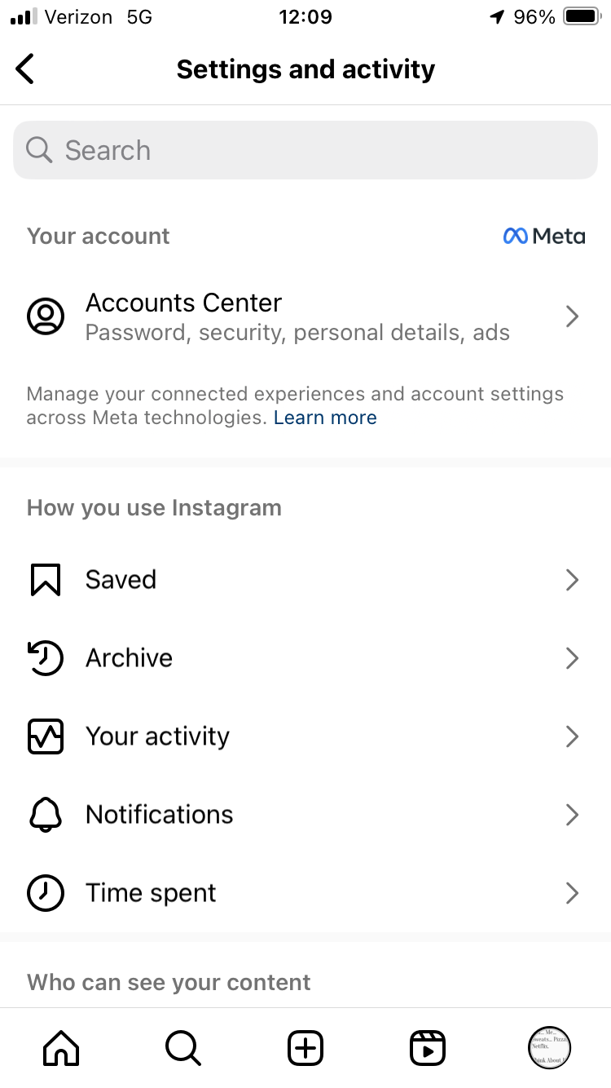
Instagram: Settings and Activity
Your activity
You can see:
what the user liked
what they commented
who they been tagged by
recently deleted post
archived posts
Time Spent
Manage time spent on application
Set break reminders
Mute notifications
Set Daily Limits

Slide 42
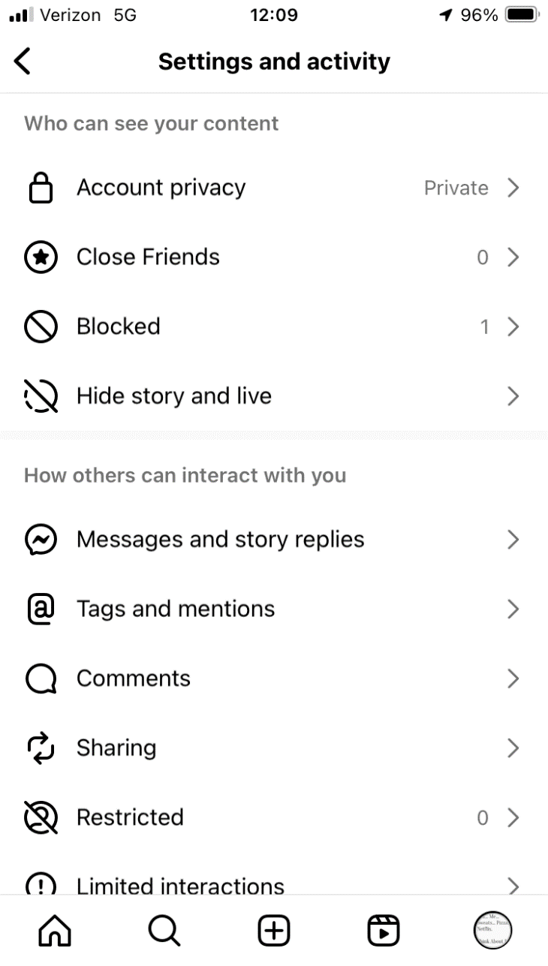
Instagram: Settings and Activity
Account Privacy: Set this private
Message and story replies
Decide who can message you
Who can reply to users stories
Tags and mentions
Control who can tag you in a post. Set this to allow tags from people you follow or don’t allow tags
Set this to manually approve who tags you

Slide 43
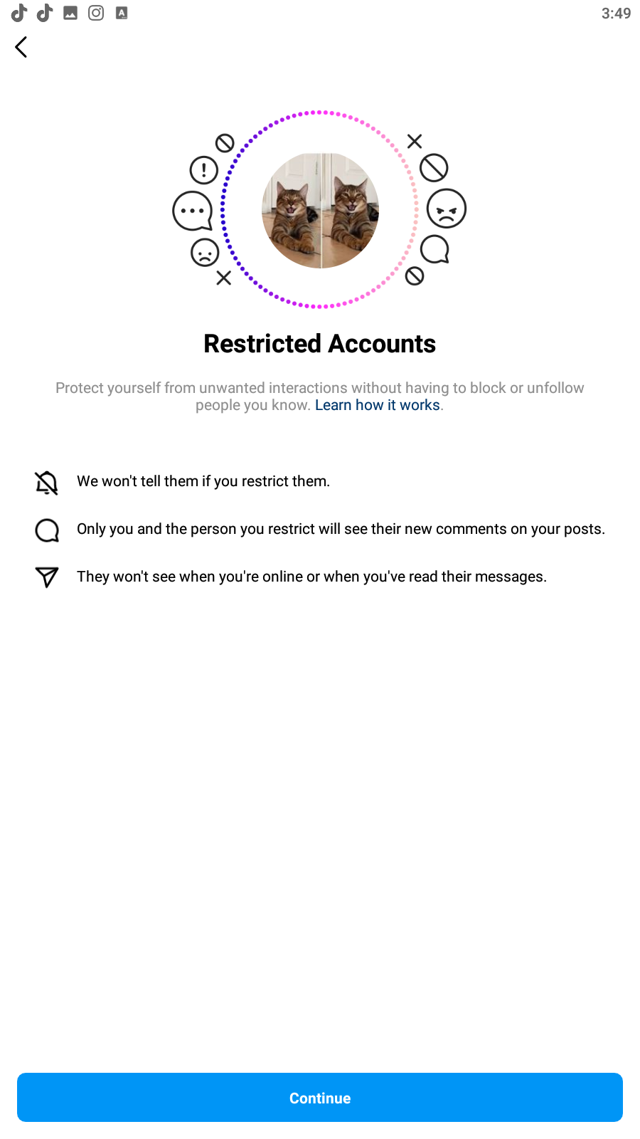
Instagram: Restricted Accounts
Add people here you want to restrict seeing certain information

Slide 44
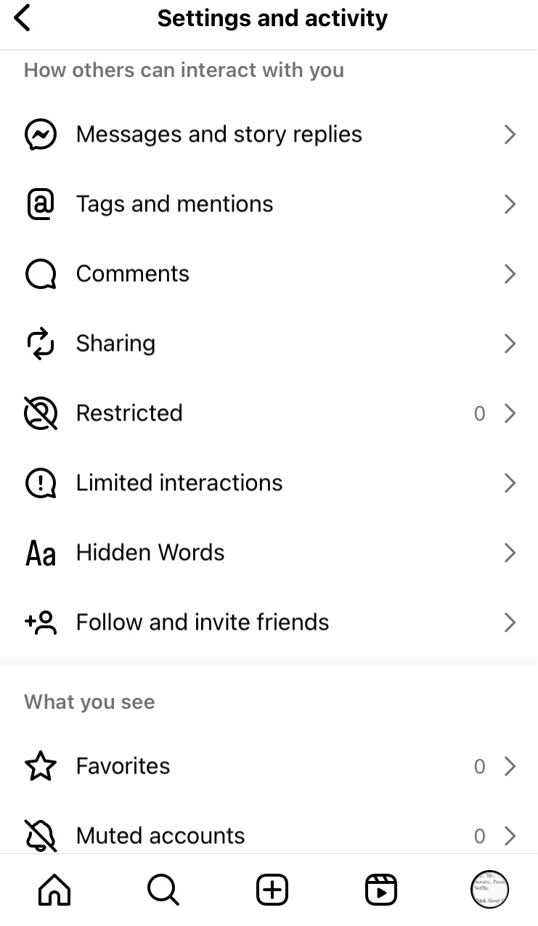
Instagram: Hidden Words
Hidden Words
Hide other user's comments
Advance comment filtering
Hide message request
Mange custom words and phrases
Scroll Up

Slide 45
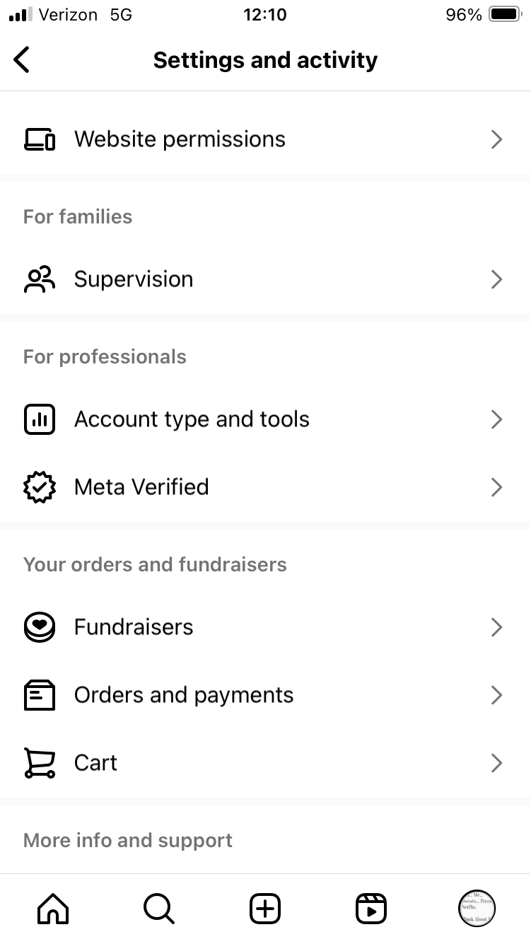
Instagram:
Supervision
This is where you set up Supervision.
Scroll Up

Slide 46
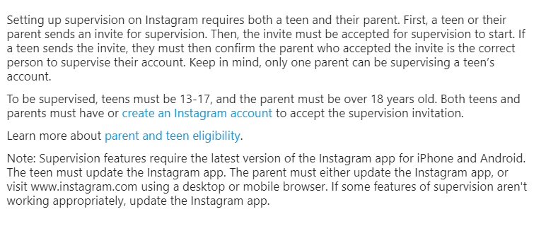
Instagram: Setting Supervision Controls
How to set up: https://help.instagram.com/472274307935829?ref=supip
To add a supervised account https://familycenter.instagram.com/dashboard/?entrypoint=fcsite

Slide 47
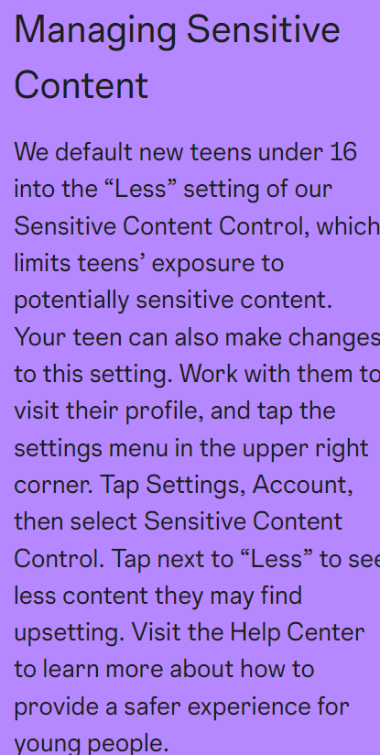
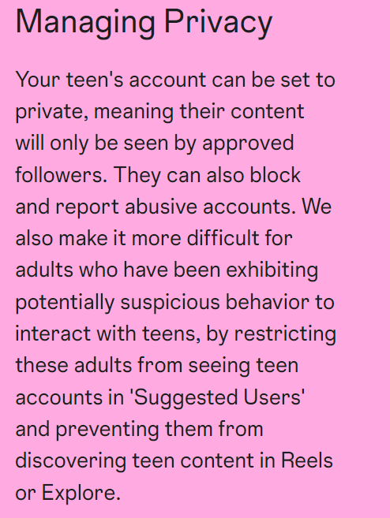
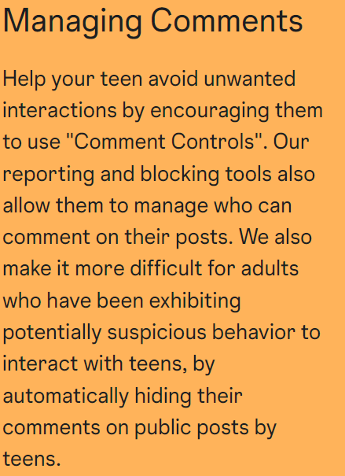
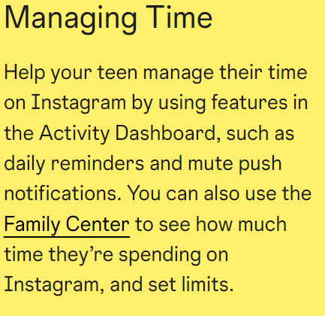
Instagram: Setting Parental Controls
Supervisions: https://help.instagram.com/472274307935829?ref=supip
What it does https://about.instagram.com/community/parents

Slide 48
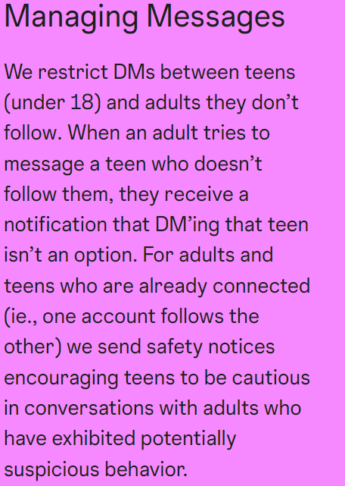
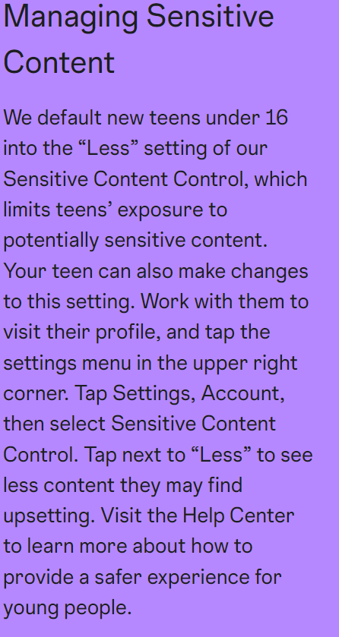
Instagram: Setting Parental Controls

Slide 50
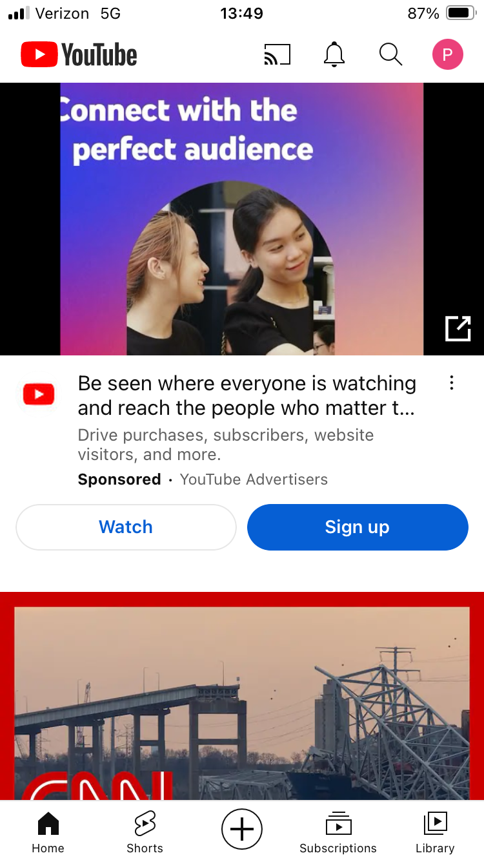
YouTube
2
This is how you get to the profile and the settings. This icon will have the users profile icon. Mine is a “P” because my profile is my name “Paul”. This profile icon may be located upper right or lower right depending on the type of device you are on.
1
YouTube mobile app home page. Click “Home” to get to homepage

Slide 51
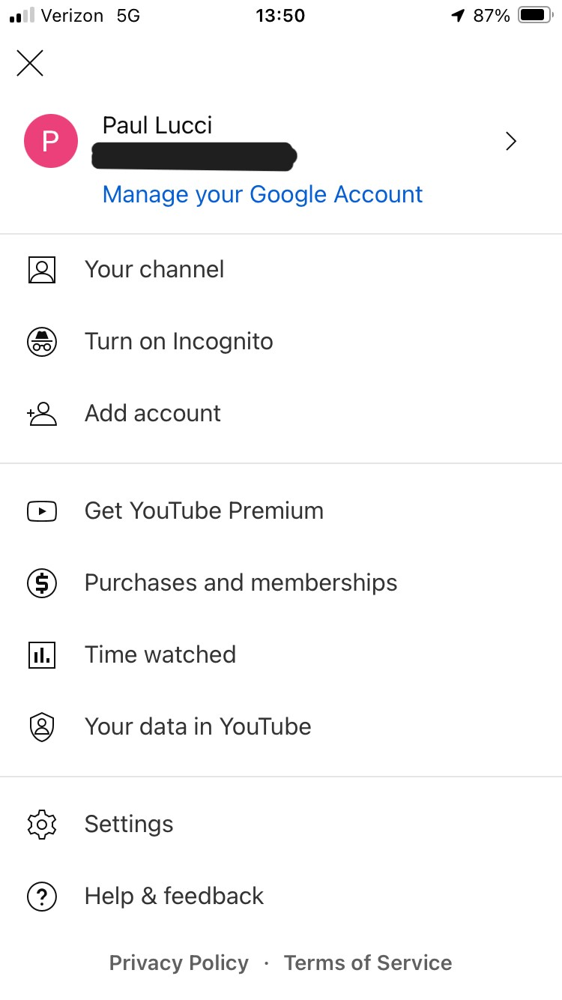
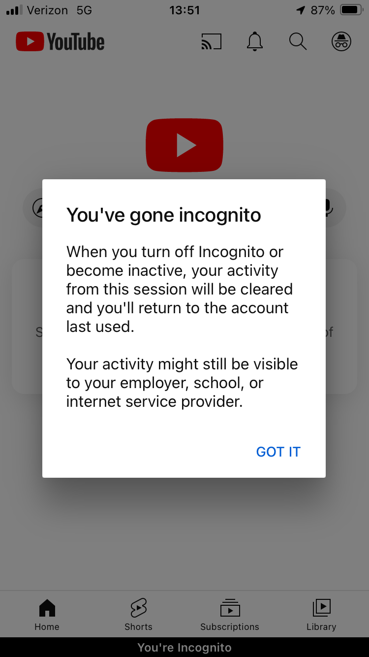
YouTube
See if incognito mode is on or off:
Incognito mode will not track what the user watches and will delete all activity once turned off or a becomes inactive.

Slide 52
YouTube:
Settings
See how much time a user is watching videos
Settings

Slide 53
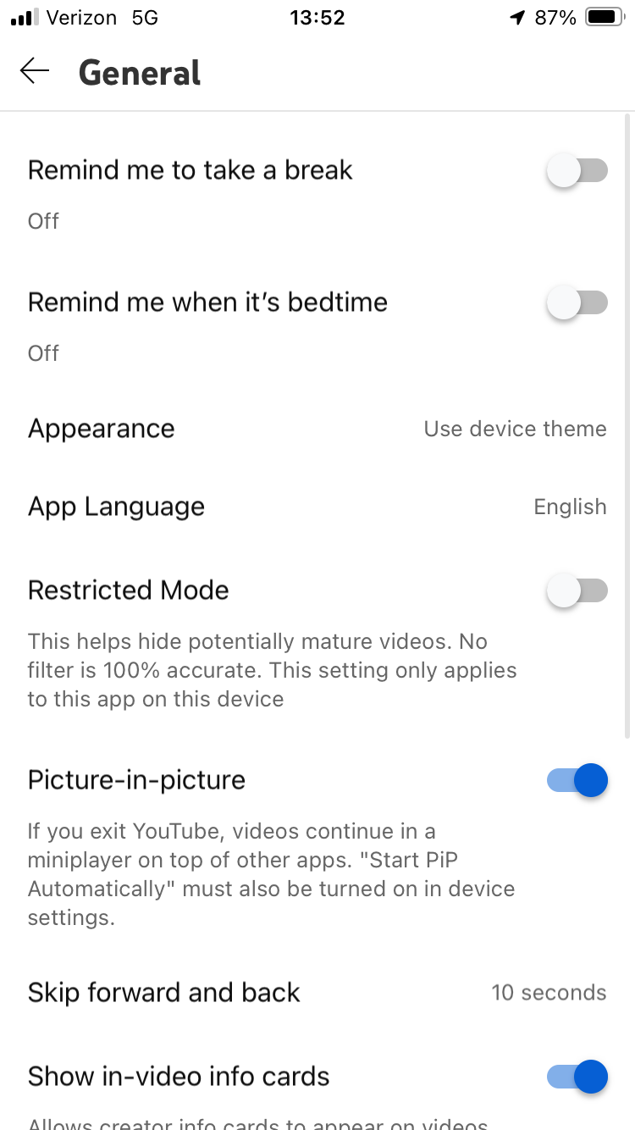
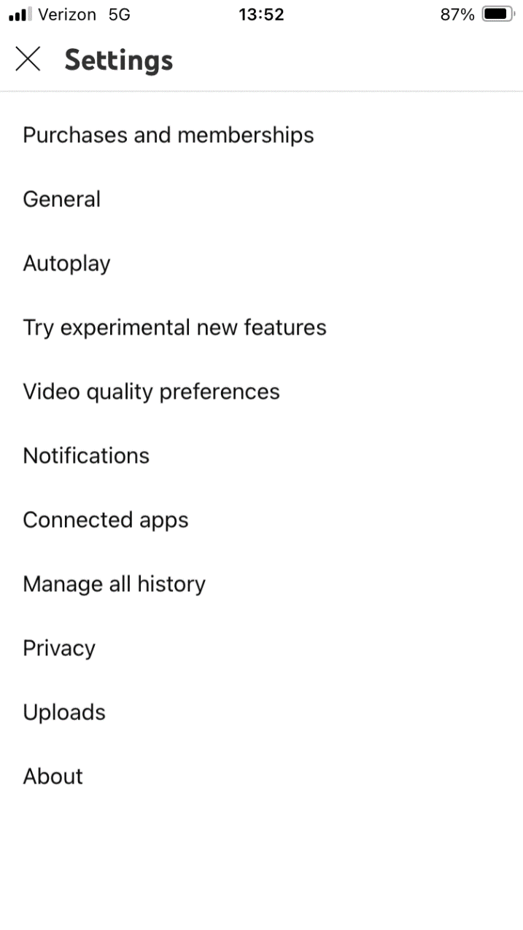
YouTube
Turn on

Slide 54
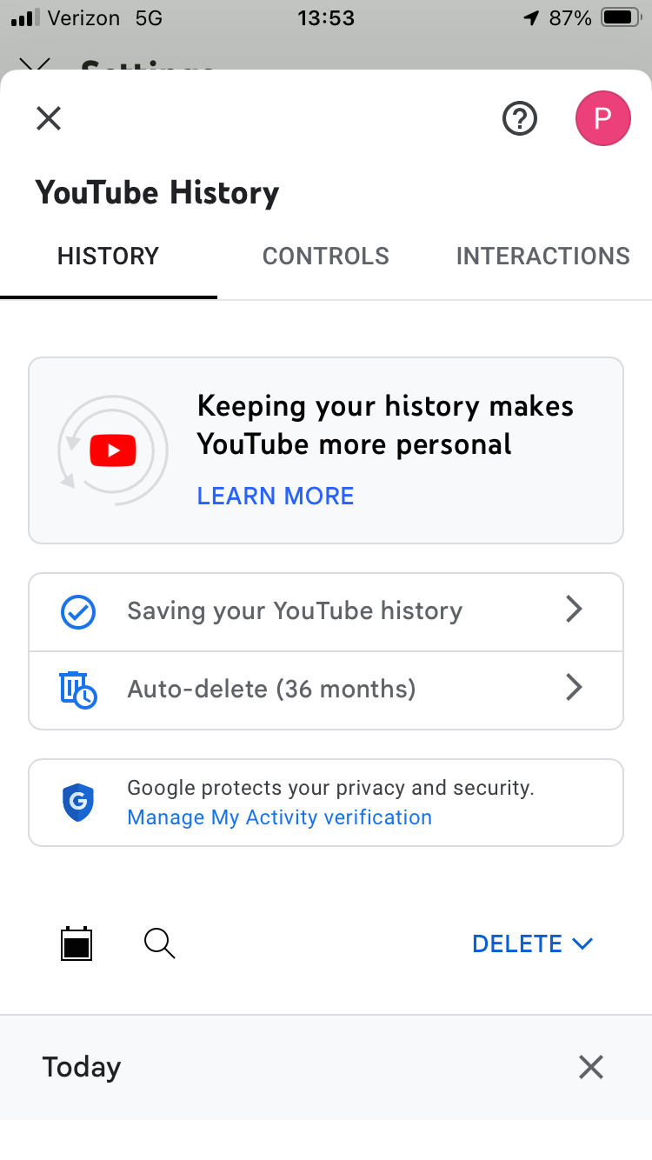
YouTube: Settings
View users watch history

Slide 55
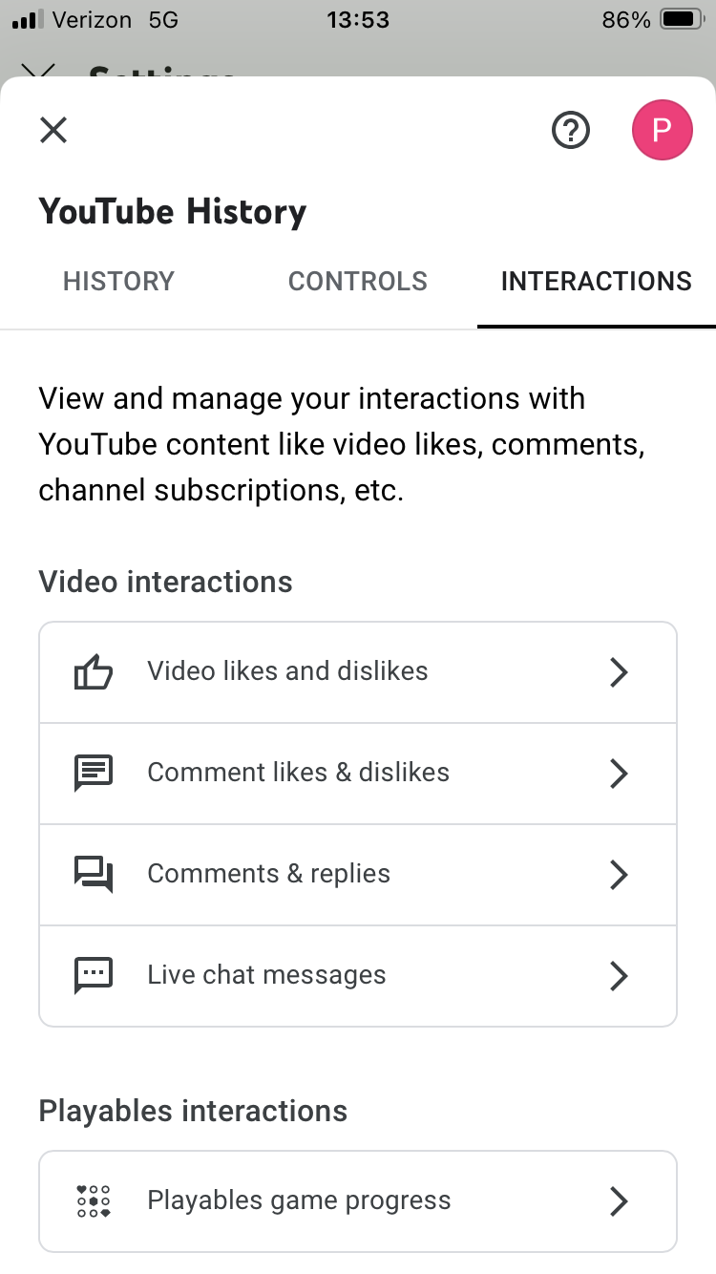
YouTube: History
Interactions lets you see the users video interactions

Slide 56
Google Family Link for YouTube
Manage your child’s YouTube Account
Option 1: Set up a YouTube kids account by downloading the app
Profiles can be set up with different age experiences
Preschool (Age 4 & under)
Younger (Ages 5-8)
Older (9-12)
Use family link to set up YouTube Controls
Option 2: YouTube supervised experience for child under/over 13 years old
3 Different YouTube Content levels for over 13
Explore
Explore more,
Most of YouTube
https://support.google.com/families/answer/10495678?hl=en#zippy=%2Chow-youtube-kids-works
https://support.google.com/families/answer/10495678?hl=en#zippy=%2Chow-youtube-kids-works%2Cwith-the-family-link-app%2Chow-youtube-supervised-experiences-work%2Cwho-is-eligible-for-a-supervised-experience-on-youtube

Slide 57
Apple iOS: Family Sharing
Family Sharing
Set content and Privacy Restrictions
Prevent iTunes and App store purchase
Allow or restrict built-in apps and features
Prevent the playback of music, movies or TV shows with explicit content.
Prevent Web Content
Change privacy settings EX: location services from being turned on in apps
https://support.apple.com/en-us/HT201304

Slide 58
Apple iOS: Family Sharing
How to set up Family Sharing
On your iPhone or iPad
Go to Settings.
Tap your name.
Tap Family Sharing, then tap Set Up Your Family.
Follow the onscreen instructions to set up your family and invite your family members.
https://support.apple.com/en-us/HT201088

Slide 59
How to set up Family Sharing
Invite people to join your family
If you choose to invite people later or want to add another member to your family, you can send an invitation via Messages, email, or in person.
If you have multiple Apple IDs, you can invite each of your accounts to the group, so you can share purchases from your other Apple IDs with your family.
On your iPhone or iPad with iOS 16 or later
Go to Settings.
Tap Family.
Tap the Add Member button
If your child doesn't have an Apple ID, tap Create an Account for a Child. But if your child already has an Apple ID, tap Invite People. They can enter their Apple ID password on your device to accept the invitation.
Follow the onscreen instructions to set up parental controls, location sharing, and more.

Slide 60
Google Family Link For Android
To use Family Link to supervise your child’s device, the child needs to:
Have a Google Account.
Have an Android device (running 5.1 or higher) or a Chromebook (running Chrome OS 71 or higher). Learn how to update your Android or Chrome OS version.
What can it manage:
Screen time limits
Allow or block apps
Find child's location
https://support.google.com/families/answer/7101025?hl=en#zippy=%2Csupervise-your-childs-device

Slide 61
Google Family Link For Android
You can use the Family Link App to create a Google Account for your child under 13 (or the applicable age in your country). You can also use Family Link to add supervision to your child's existing Google Account.
Important:
Family Link may not be available in all countries or regions.
iPhones, iPads, and computers other than Chromebooks can't be supervised with Family Link.
Google Workspace for Education accounts can't be managed by Family Link.
Family Link’s purchase approval settings only apply to purchases made through Google Play’s billing system.
https://support.google.com/families/answer/7101025?hl=en#zippy=%2Csupervise-your-childs-device

Slide 62
Google Family Link For Android
Important: To see your child's Android device location or remotely manage their screen time and apps, you need the Family Link app.
As a parent, you can use Family Link to do things like:
Change some of your child's Google Account settings.
Manage your child's apps on supervised devices: Decide which apps your child can download or purchase, block or allow apps, and change app permissions.
Manage your child's screen time on supervised devices: Set a bedtime or daily screen limits, and see how much time your child spends on certain apps.
Check your child's Android device location.
Restrict mature content on Google Play.
https://support.google.com/families/answer/7101025?hl=en#zippy=%2Csupervise-your-childs-device

Slide 63
Google Family Link For Android
Manage your child's Google Account
To use Family Link to manage your child’s Google Account, you need to:
Have a Google Account. If you don’t have one you can create a Google Account at no charge.
Be 18 or older (or the appropriate age in your country) and have a Google Account.
Have an Android device (5.0+), iPhone or iPad (iOS 13+), or a Chromebook that supports Android Apps to download the Family Link app on. You can also manage some settings at g.co/YourFamily.
Live in the same country as your child.
https://support.google.com/families/answer/7101025?hl=en#zippy=%2Csupervise-your-childs-device

Slide 64
Red Flags for Digital Behaviors
Digital dashboard shows you’ve hit limits every day or nearly every day
Isolation/changes in behavior
Phones in bed, checking when waking up
Phone bills
Batteries are depleted quickly/frequent charging
References that are not age-appropriate

Slide 65
What can caregivers do?
Start conversations about safety as early as possible, even before children go online, about:
boundaries
healthy relationships
empathy
consent
rejection
healthy development
Conversations must be continuous with genuine curiosity to strengthen your relationship with your child. You will ask those questions about their offline activities and friends, so let's do the same thing about their online interactions.

Slide 66
What can caregivers do?
Ask questions
What’s your favorite app? And why?
Who do you talk to when you play games? How do you know them?
What are the games about? ask them to teach you how to play
Kids need to know that they can trust you, that you are a source of information for them
We must understand that for kids, the online and offline world are interconnected and equally important for their social and emotional development
Be honest and tell them that even though you might get upset, your main goal is to protect them and help them

Slide 67
What can caregivers do?
Here are some options you may want to look into:
Filtering and monitoring software - These can help protect your children from seeing sexually explicit content online and even notify you if they’re receiving inappropriate messages. NCMEC does not endorse any particular kind of software, but you can search for the software that best fits your needs.
Consult your cell phone service provider - They may offer monitoring options for your child’s cell phone.
Research options for mobile devices – Laptops, tablets, handheld games, cellphones, watches may have built-in monitoring options or software for purchase.
Look at the individual apps they’re using - Many apps have the option to turn off chat features or limit who can see what your child posts within the app.
Explore built-in security features for programs and websites - These often have their own privacy or filtering services. For example, Google has a free SafeSearch option, parental controls, and other security tools.
Each website or app has different privacy and filtering settings, so you should consult each one to help you better understand their systems. If you have specific questions, you can write to NetSmartz at MissingKids.org/contactus

Slide 68
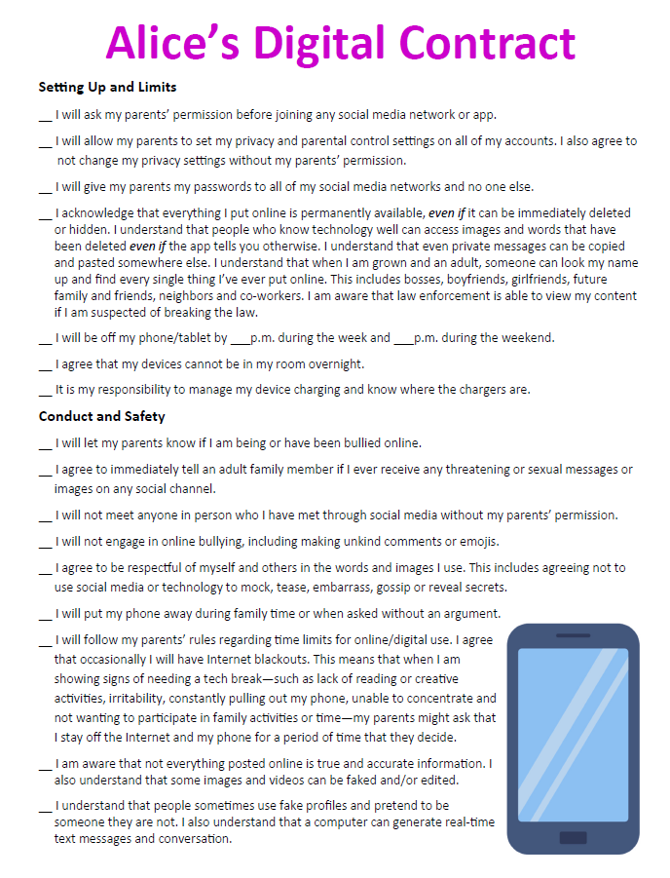
What can caregivers do?
Tips for a Successful Digital Contract
Edit it for age-appropriateness
Clearly outline consequences
Decide when you will revisit the contract (in a few months? after a special birthday?)
Keep it visible/accessible
Decide if the adults have any agreements too like not using phones at the dinner table. Modeling behavior is important.
Consistently follow-through with agreements!

Slide 69
Text-a-Tip
P3 App
Call (781)357-5151
Visit www.nrpd.org
Submit NRPS App

Slide 70
Let us know! Please take this 1-minute anonymous survey.
Contact us!
Today’s Workshop:
Amy Luckiewicz
(781)588-0257
coalition@northreadingma.gov
Det. Paul Lucci plucci@nrpd.org
Setting Social Media and Digital Boundaries
www.surveymonkey/r/2024Noodles

